Slide 1

Winlink Introductions

Slide 2

Winlink Is
Communications system for License Hams
Able to send and receive email over radio
Particularly useful in Emergencies
Users can use various methods
  Telnet
  UHF/VHF, HF

Slide 3
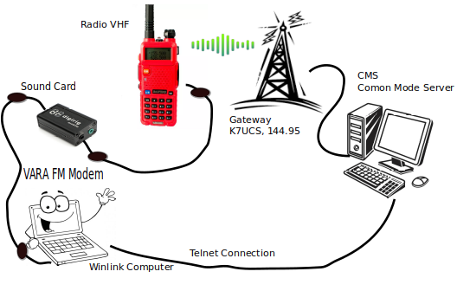
System Setup
Most items can be purchased on Amazon.
Cables
Digirig – sound cards

Slide 4
Installation
Go to downloads.winlink.org
Perform a regular install on your system
Obtain winlink account email address
Fill out Setup Screen
  Call sign
  Password
  Locator number, etc

Slide 5
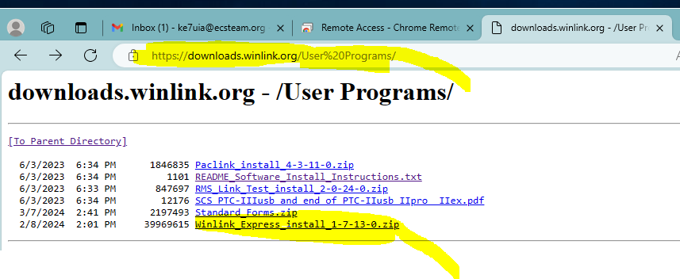
Download.winlink.com

Slide 6
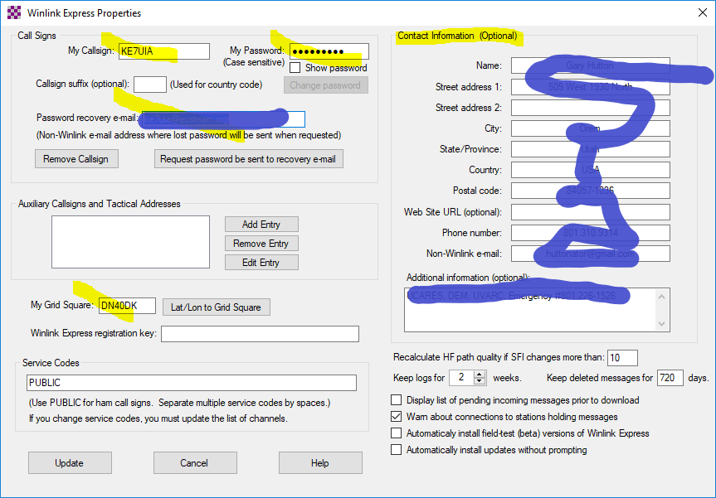
Setup screen

Slide 7
Obtain email address
Read instructions on winlink.org
Youtube.com is your friend
Your winlink email address is just your call sign
Example = ie. ke7uia

Slide 8
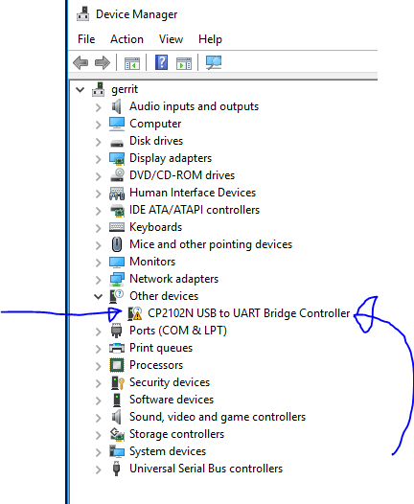
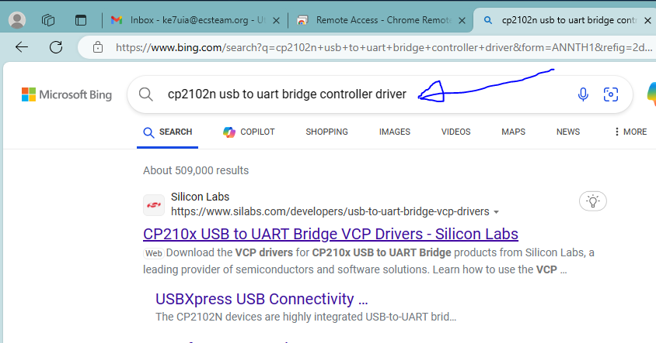
Install Drivers

Slide 9
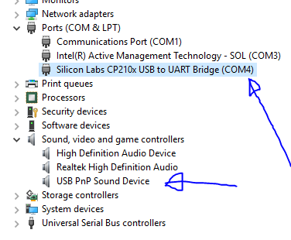
Com Ports

Slide 10
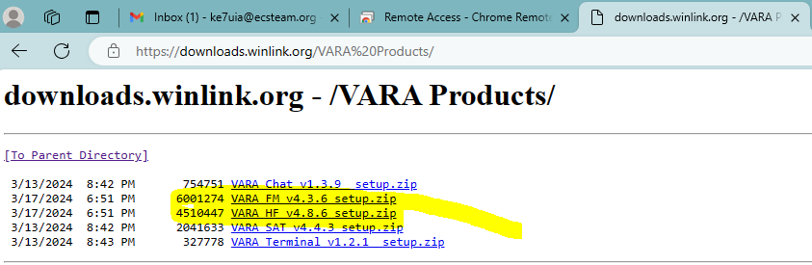
Download VARA FM

Slide 11
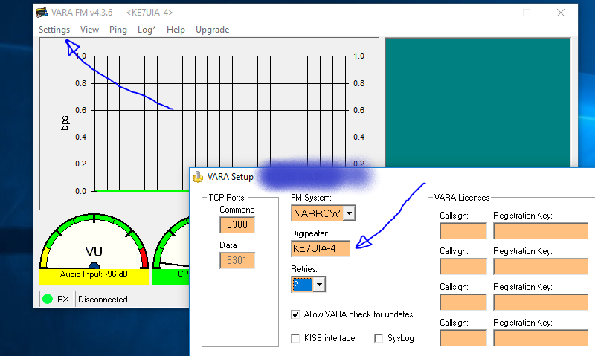
VARA Settings

Slide 12
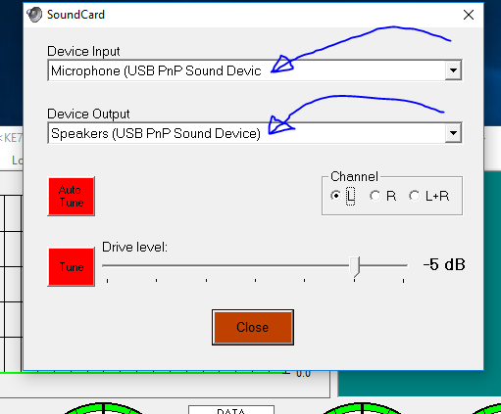
VARA – Sound Card

Slide 13
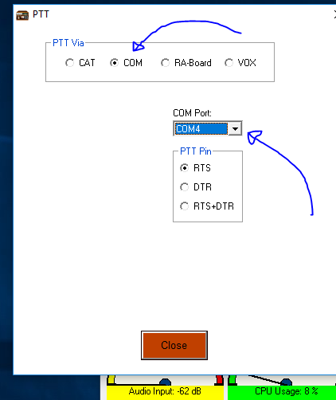
VARA – PTT Port

Slide 14
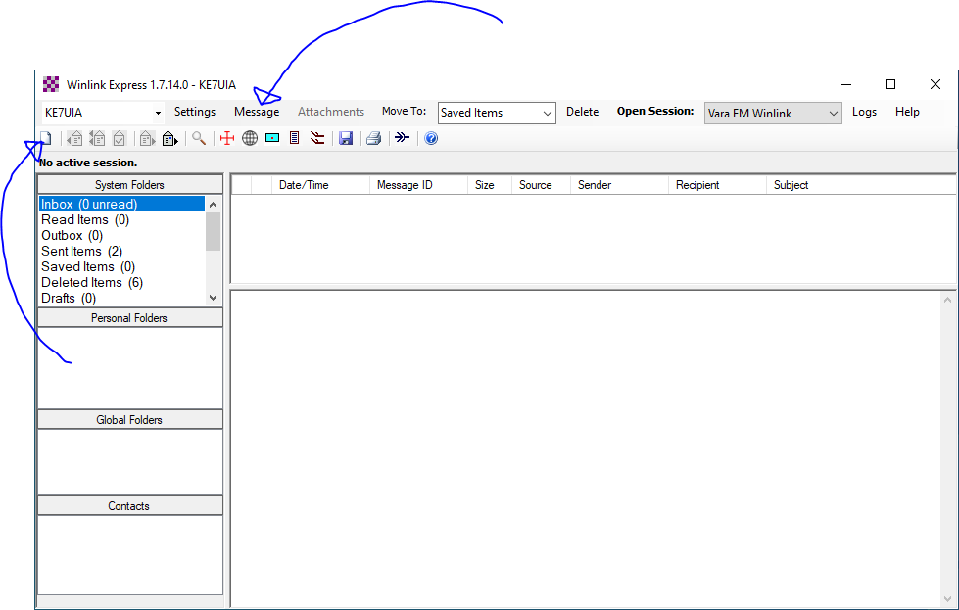
Create Message

Slide 15
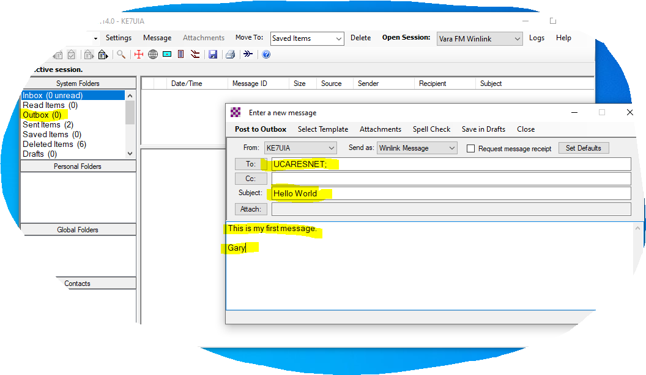
Create Message 2

Slide 16
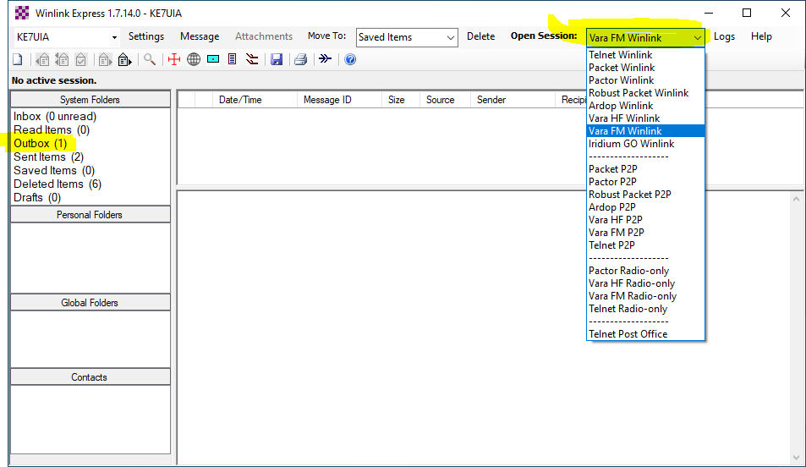
Select Session Type

Slide 17
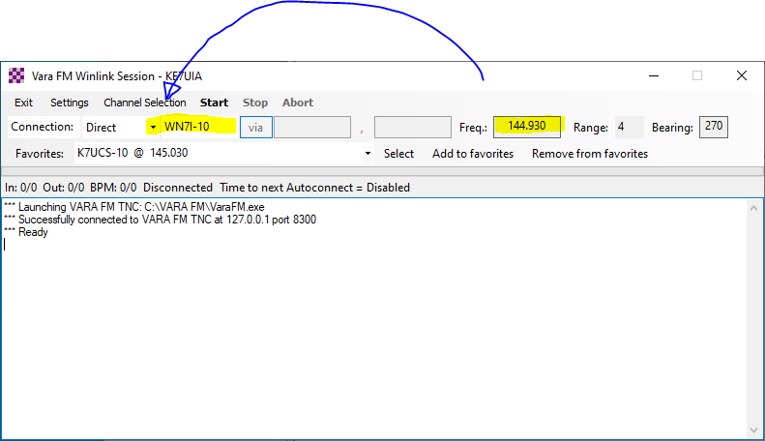
Select Channel

Slide 18
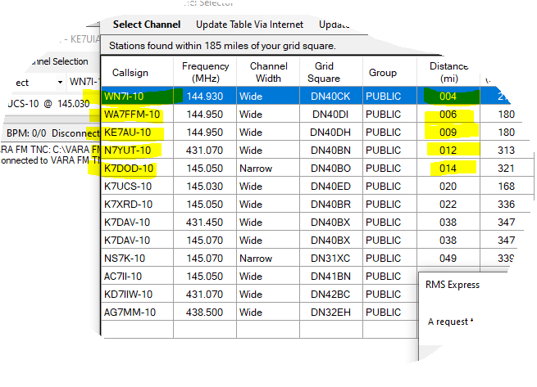
Select Channel 2

Slide 19
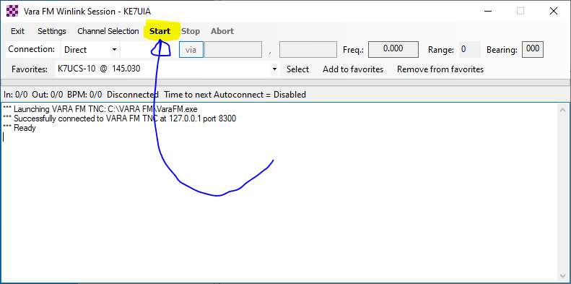
Press Start

Slide 20
Message Path with VARA
Message: Posted in outbox. Addressed correctly
Session Type: VARA FM, VARA HF
Configuration: Sound cards, PTT
Select Gateway: one near you
Cables to Sound Card: short and choked
Cables to Radio: short and choked
Sound Card: digirig, Tigertronics
Radio: frequency, settings, power
Antenna: Type, Position, Connections
Gateway: is it up and running
When this method of sending winlink email is broken, which one of these is broken?

Slide 21
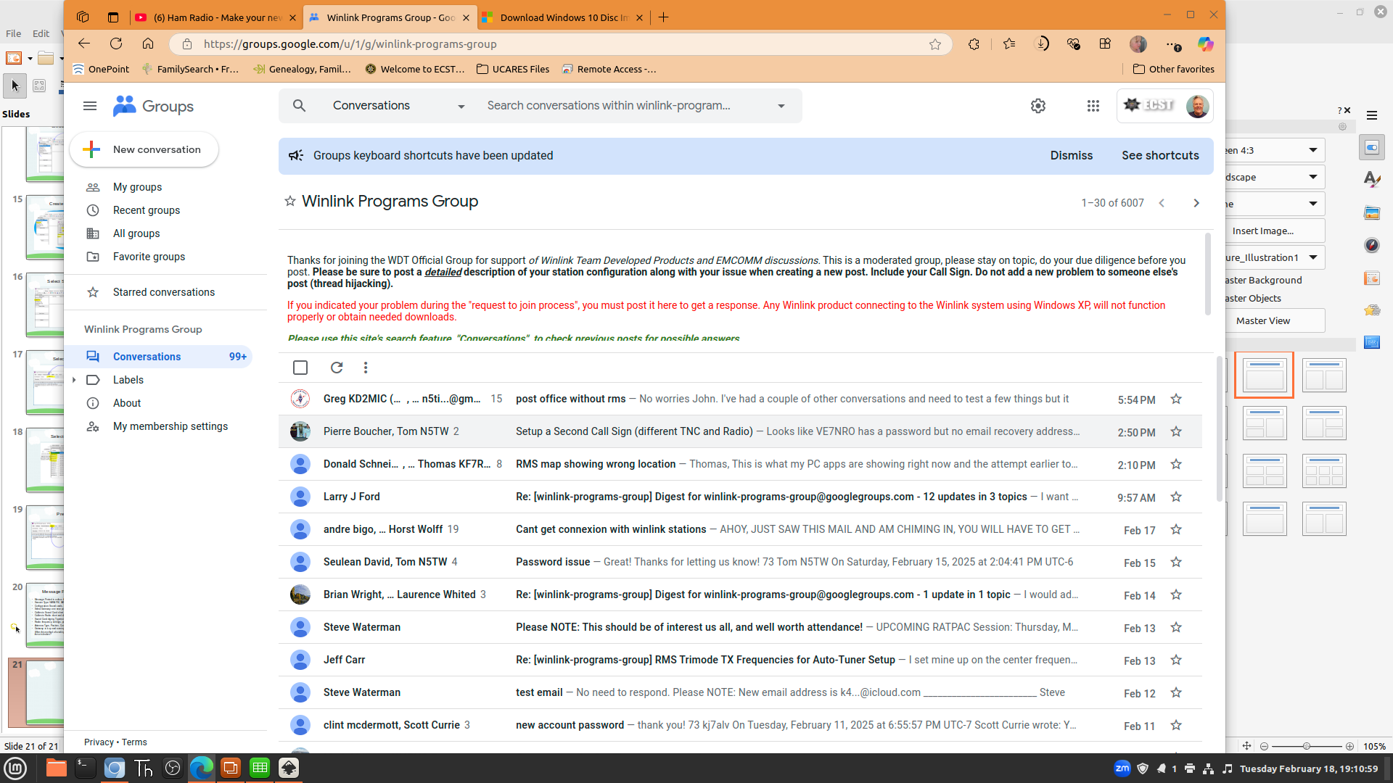

Slide 22
Winlink Info Locations
https://winlink.org/
  User Programs, Book of Knowledge, Support, Maps, My Account
https://github.com/ke7uia/Winlink
Linux installations
  https://github.com/km4ack/73Linux
https://www.youtube.com/@WaveTalkers

Slide 23
Questions:

